Slide 1
Predicting the Recurrence
of Thyroid Cancer for
Post-Treatment Patients
Alex Lai
Notes:
For context I will be presenting to my project manager of the company developing the drug, so half technical and half show quickly to not waste their time.
My name is Alex Lai and I would like to show a quick prototype that we have been working on for the company’s new thyroid cancer drug treatment.

Slide 2
Content
Problem Statement
Description of Dataset
Data Wrangling
Exploratory Data Analysis (EDA)
Feature Engineering
Modeling
Result Analysis & Limitations
Conclusion, Future Work, & Improving the model
Notes:
These are all the contents that we will be going over for today.

Slide 3
Problem Statement
To make a predictive model for thyroid cancer patients to see how likely after treatment their cancer will reoccur.
New patient eligibility test for the treatment
Accuracy
At least 95%
Stakeholders
company developing the treatment, doctors, patients
Solution Space
Decision Tree based model using Pandas.
Constraints
limited amount of data
Time Frame
This will be completed within the next 3 months
Notes:
To make a predictive model for thyroid cancer patients to see how likely after treatment their cancer will reoccur.
This model is especially useful for doctors to use as an eligibility test to see if the patient is right for the treatment.
Accuracy has to be above 95% to be considered successful.
Stakeholders would be the company developing the treatment, doctors, and the patient themselves
Solution Space will most likely be creating the Decision Tree based model using Pandas.
Constraints would be the limited amount of data to train and the quality of the data.
Time Frame to deliver this project will be within the next 3 months.

Slide 4
Description of Dataset
This data was provided by the UCI Machine Learning Repository:
https://archive.ics.uci.edu/dataset/915/differentiated+thyroid+cancer+recurrence
And is available on Kaggle:
https://www.kaggle.com/datasets/jainaru/thyroid-disease-data
This data under the license CC BY 4.0 ATTRIBUTION 4.0 INTERNATIONAL Deed: https://creativecommons.org/licenses/by/4.0/
Notes:
We got the data from UCI Machine learning repository and kaggle. We have permission due to the CC 4.0 attribution license which we are attributing to them now

Slide 5
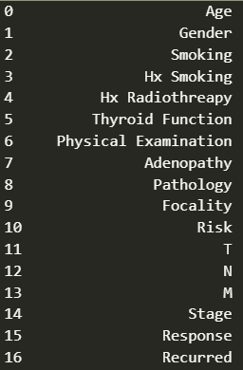
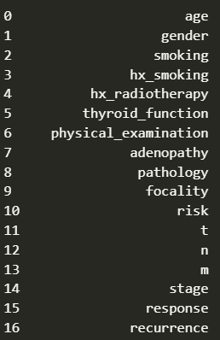
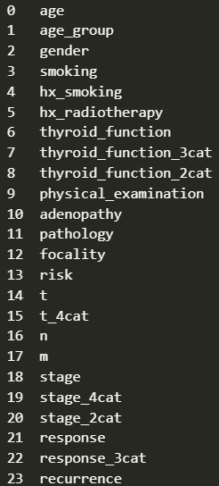
Data Wrangling
Notes:
Now the real meat of the presentation
Each row represent a patient that has some form of Thyroid Cancer. We have 383 rows / patient data.
This data practically all categorical. As you can see up here, these are all the columns.
I standardized the columns to make them all lowercase and replace spaces with underscore ,
also fixed the typo in hx_radiotherapy,
and rename ‘recurred’ column to recurrence to make it more standardized for other medical professional terms as trying to remove as much ambiguity as possible.
I handled all remaining standard data cleaning, fixed up all the missing values, duplicate values, and rename misspelled values.
Then I quickly merge specific data together into new columns which EDA may want to use.
Age is our only numeric column but to make it categorical with the rest I bin it into age groups.
The other categories I merged had values that were somewhat duplicate and think maybe combining them can create better variance info for the model, then added those as new columns.
For example, the ‘response’ column had 2 categories that were about different types of negative response so I merged them into one.
So back our ‘problem identification’, we are trying to make a model that can input new patient data and predict if thyroid cancer come back will occur after treatment.
Thus the column we would be focusing on is ‘recurrence’

Slide 6
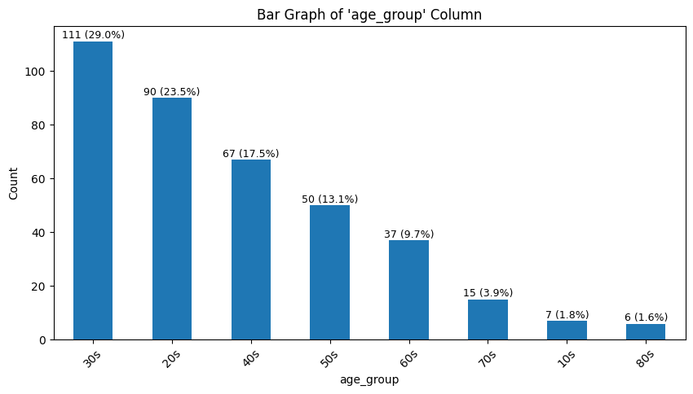
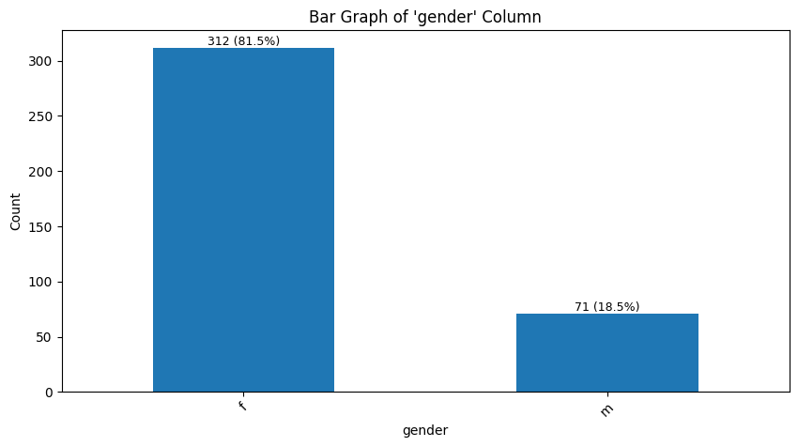
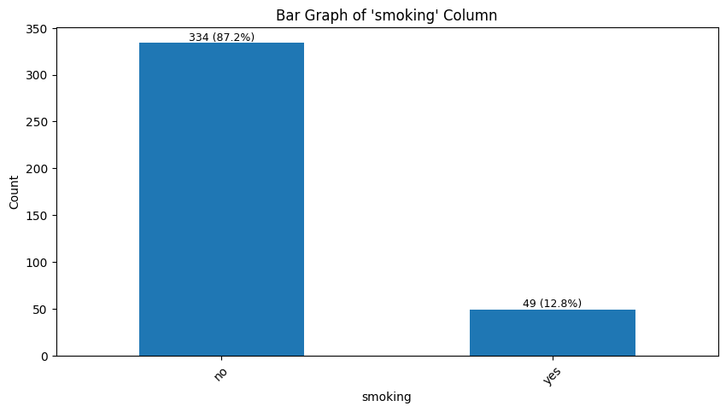
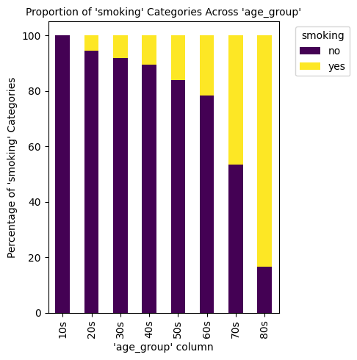
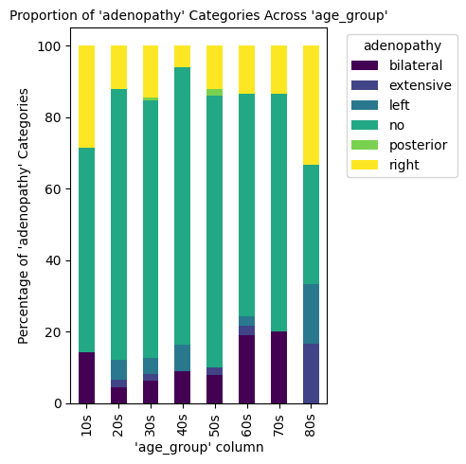
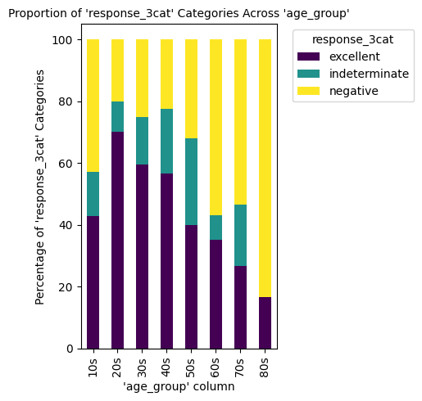
Exploratory Data Analysis (EDA)
Notes:
For EDA we did lots of data, If you want more details you can request to see all our data,
But I will go through the more interesting data

Slide 7
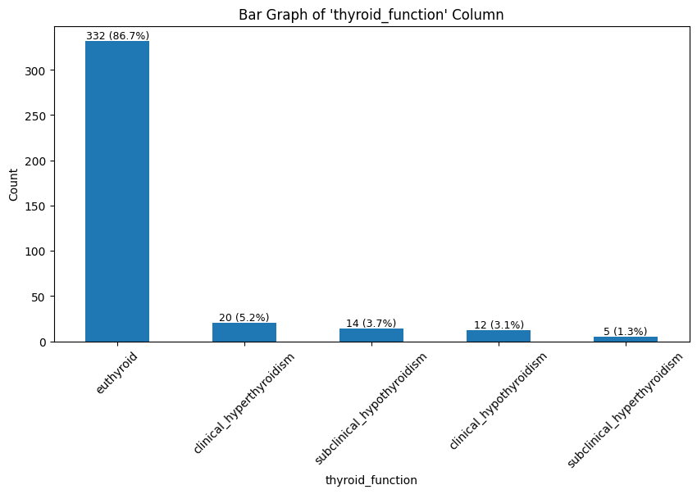
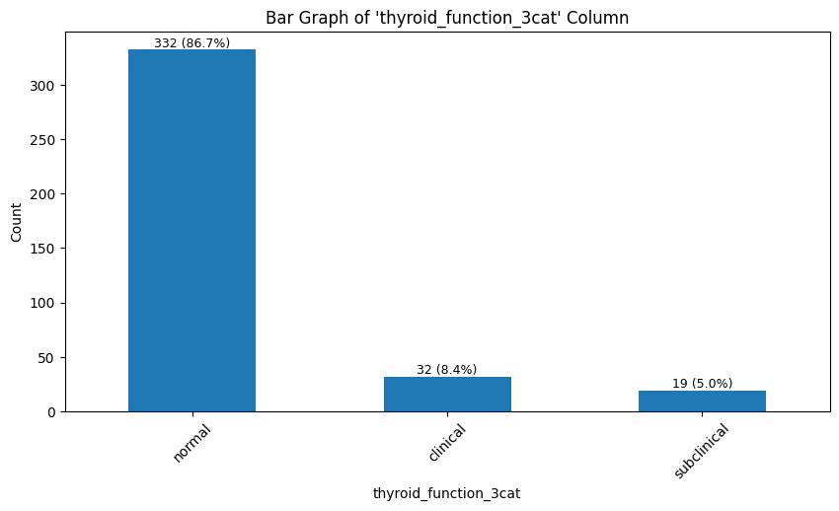
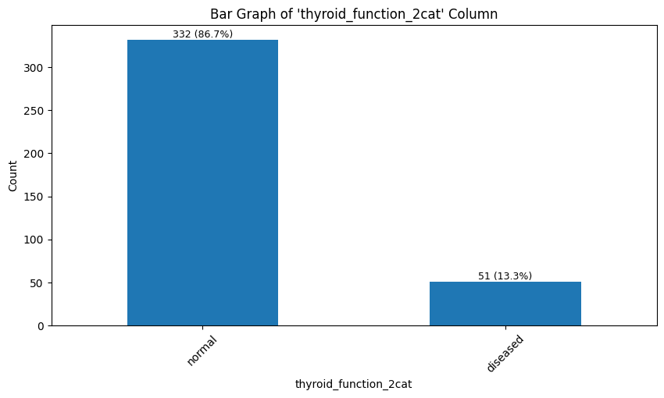
Exploratory Data Analysis (EDA)
Notes:
“Example Go further why we merge data,

Slide 8
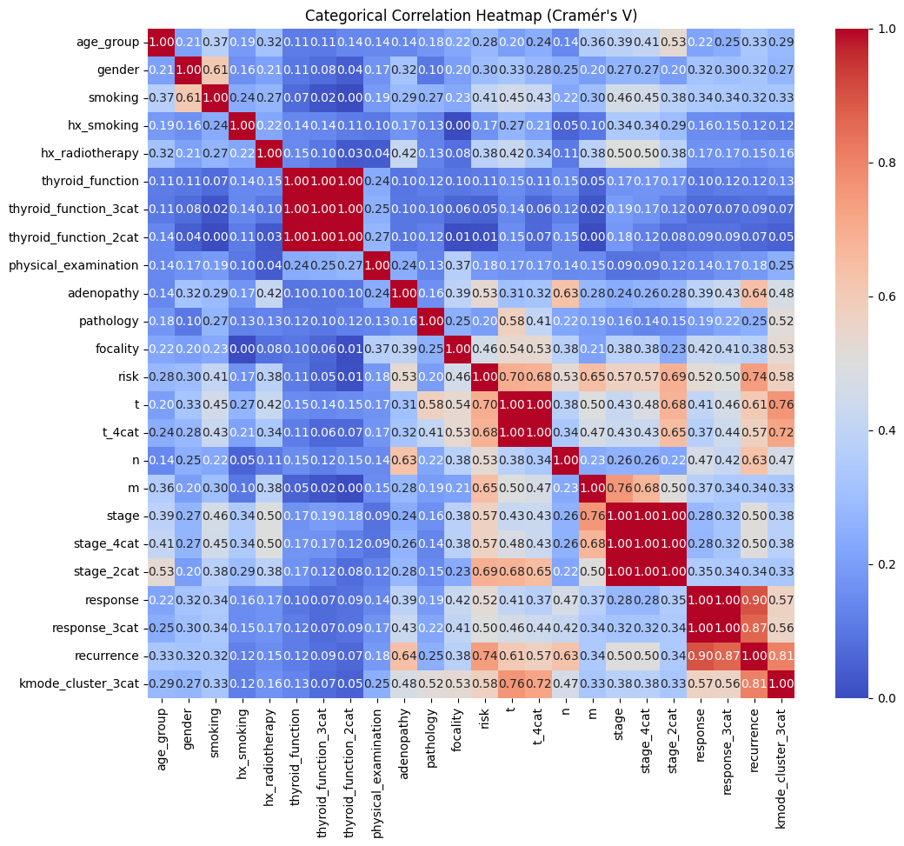
Exploratory Data Analysis (EDA)
Notes:
So to Show which columns have correlation with each other, I made a Cramer V correlation heat map.
Just to give note the limitation, all the numbers represent association but does not say that if the association is direct or inverse. This is because all our columns are categorical and not numeric
I will be checking to see which features have strong associations with each other, but mainly focusing on 'recurrence' as that is what we will be used for label in training.
Merging the 'response' column into 'response_3cat' was a good move as combining both negative categories together gave it more variance info. However that column is related to post treatment and the goal of this project is to make a predictive model that is pretreatment based on info from examination.
'Risk' column has high association, but that feature is inputted vaguely by the doctor.
'Adenopathy' and 'n' column has high association and can work as is less vague and more clear observation based. Both are similar as related to the observations of the appearance of the disease.
It seems merging the 't' column into 4 categories made it have slight weaker association with recurrence. This means that the different sub categories in the 't' column does contain important variance info.
It seems merging the 'stage' column into 4 categories has no difference.
Interesting experimenting with k mode clustering the data into 3 groups have high recurrence, will have to look into it further if meaningful or relying heavily on the recurrence column.

Slide 9
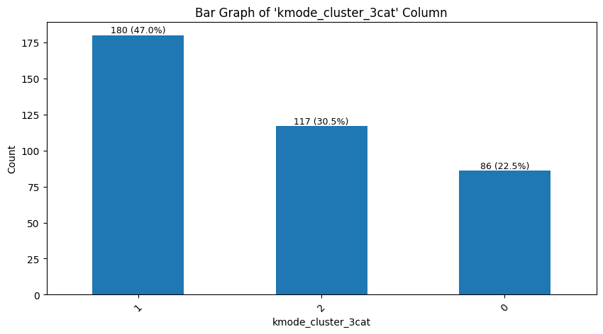
Exploratory Data Analysis (EDA)
Notes:
We also perform K mode clustering to see if there are specific patterns of groups, which may hold promise so we included as a new column.

Slide 10
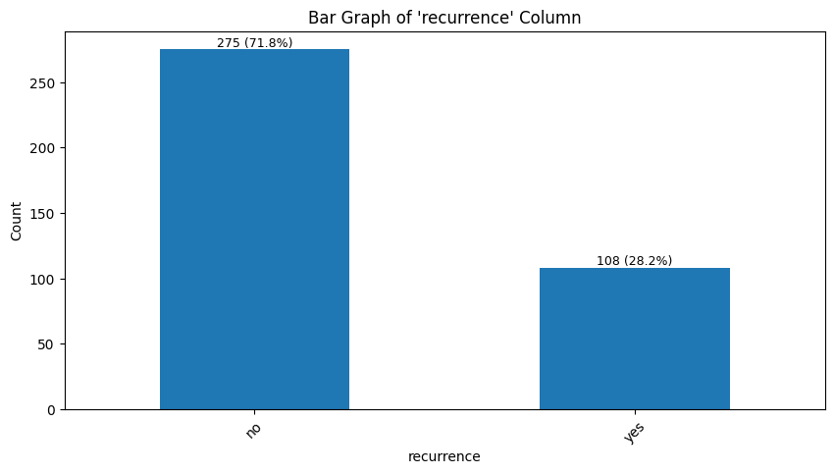
Exploratory Data Analysis (EDA)
Notes:
Here is the recurrence column which will be out model’s labels
Exploring noticed alot of data imbalance with this data set. Which we will have to address later

Slide 11
Feature Engineering
Encoding
Dummy encode binary
One hot encode categories
Label encode categories
Notes:
“Not much to go over here
“ We did all
“ in the end we chose to dummy for binary and label for categories as for mu

Slide 12
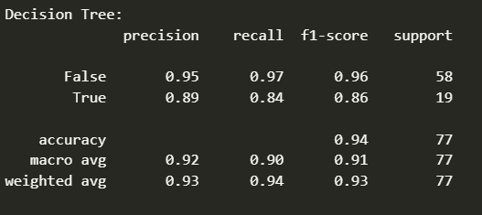
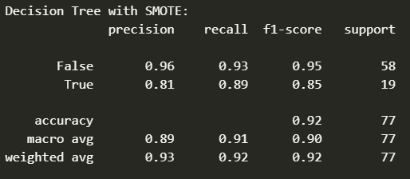
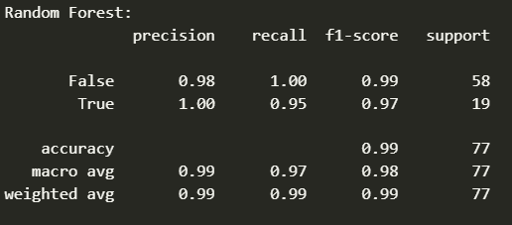
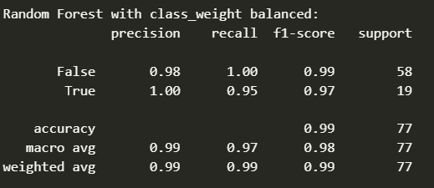
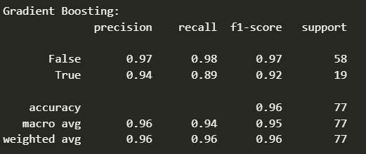
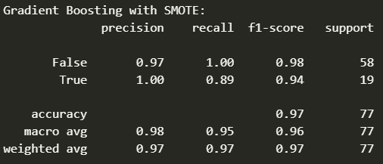
Modeling
Native with imbalance data: Balanced Data Modifications:
For those that need a quick read, focus on:
F1 Scores and Accuracy
The higher the better
Notes:
Due to all our features being categorical data, we find it best to use tree based models.
We made 3 models (basic decision tree, Random Forest, Gradient Boosting), and for each of them I tried another version using methods to balance out the test data.
Yes this is a lot of data but those that need a quick read
main thing you would just need to focus on is the F1 scores for both True and False, and accuracy metrics. The higher the score the better.
The rest of the info is available if you want a more technical observation.
As you can see, all 6 models reach the required accuracy of 95% from the problem identification.
Both ensemble decision trees method work really great and can natively handle imbalance data well. But the random forest method seems suspiciously high precision and recalls
And of course balancing the data pretty much increase all stats in all models except of decision tree for some reason.
In the end I decide to go with the Gradient Booster with SMOTE as seems to have the a really high performance while being less suspicious of overfitting.

Slide 13
Conclusion, Future Work, & Improving the model
Conclusion:
Chose the Gradient Booster with SMOTE model
Future Works:
Partner with hospitals to get more consented user data.
Explore more if overfitting.
Explore the Random Forest model more.
Expand the model to include cross reactions.
Possible issues:
CC 4.0 Attribution license
Notes:
Conclusion:
We came in trying to make an eligibility test model for doctors to predict if our company’s durg will
We will be using the Gradient Booster with SMOTE model do it’s it’s high F1 scores and accuracy.
Future works
Currently for this prototype our data amount is lacking, and I would love for our company to partner with hospitals to get more consented user data.
Also I would like to do more experimentation on all the models to see if they are overfitting or not,
and research more on Random Forest to see what is up with it’s high precision and recall.I am more partial to random forest as I love the concept of it’s parallel computing which means when we do partner with hospitals to get more data this model would be easily more scalable, or future proofing it.
WWe can further expand on this model more to include cross reaction chance with other drugs or stats
Possible issues
I do not know if management will find using the CC 4.0 Attribution license data an issue, as if we release the product with this data set then we would have to say somewhere on the product this data set is included. If needed when we do get the hospital data we can remove this dataset and it’s label.
Overall I think we are on track to fine tuning and finishing up this model for production.
Mentor feedback
Need to do cross validation after choosing the model

Slide 14
Thank You
Questions?
Notes:
Thank you that’s all, any questions?

